Slide 1
Design and Technology

Slide 2
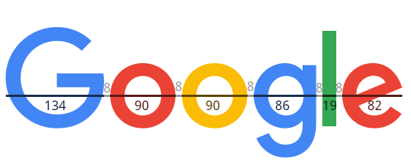

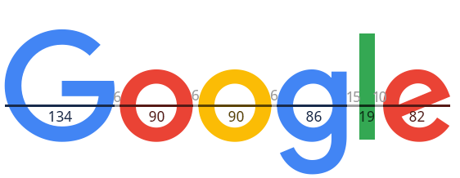
The Smallest Changes
It may seem like a small alteration but, it may have lessened the great outcry for displeased Googlers when Google decide to change their logo. A small change in the spacing of the new letters can make the logo more appealing to some. The slightest design change can make a world of difference.

Slide 3
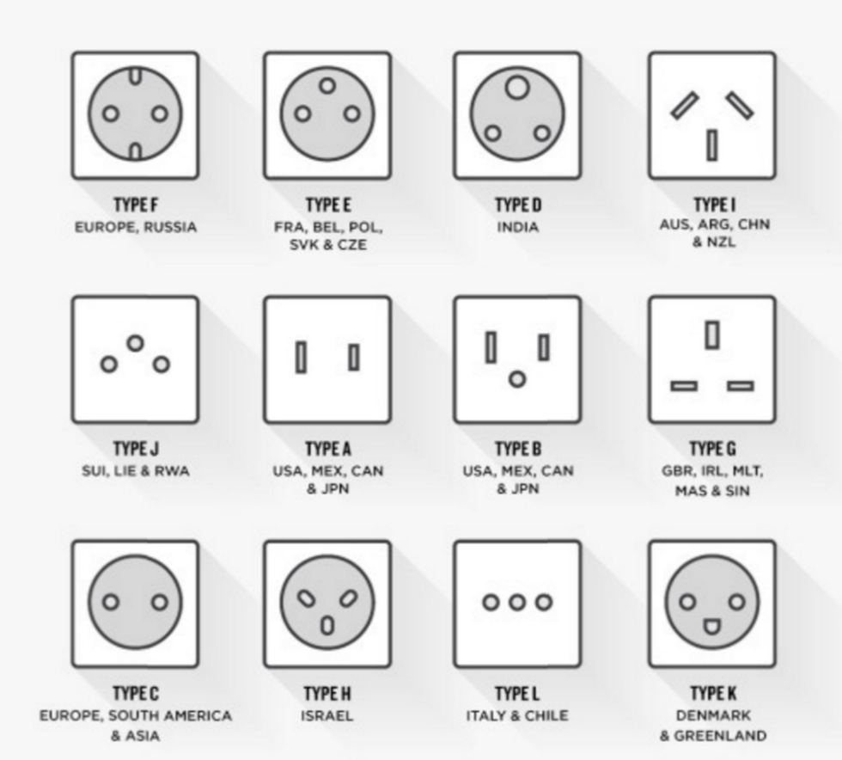
Power Plugs
-- The design of power plugs and voltages around the world vary greatly and commonly cause confusion for travelers. Some countries don’t have a common standard within their own country.
-- This stems from the history of the power plug and the separate attempts to design a power plug that would allow the average individual access to electricity.
-- Despite this, they still work. People have electricity and, aside for a few mad travelers, no steps have been made to change it. This makes it a rare case where poor design does not affect a technology.

Slide 4
The Internet
-- The design of the internet was designed with little thought of what it could become in the future. When establishing internet protocols, the IPv4 address was established as a way for establishing communication between computers.
-- However the number of IPv4 Address, although extremely large, is still limited. This shows how poor initial design can doom a technology years ahead.
-- There is a solution to this, IPv6 address, which although also limited have a much greater number making it an issue that we may possibly never encounter.
IPv4 Address:
128.168.0.1
IPv^6 Address:
2001:0:5ef5:79fb::f8fe:3fffdfe

Slide 5
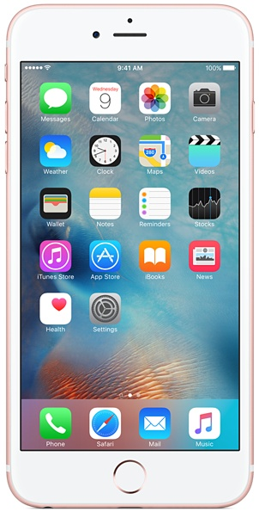
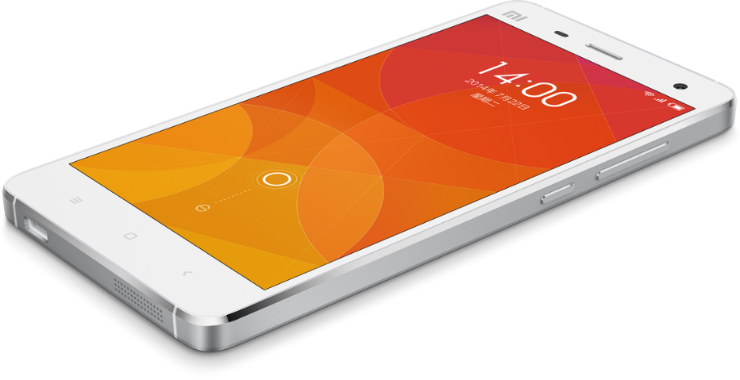
The Apple of China
-- A Chinese company called Xiaomi has become famous for being, well, the Apple of China.
--Their phones have a known history of being, technically speaking, designed externally well. Nothing extra is added making for the best possible phone.
-- Typically unique designs are the ones that become the most prosperous yet Xiaomi breaks this as it has become extremely prosperous and famous in China.
-- This goes to show how appealing design is critical even if they effectively “borrowed” the design from Apple.

Slide 6
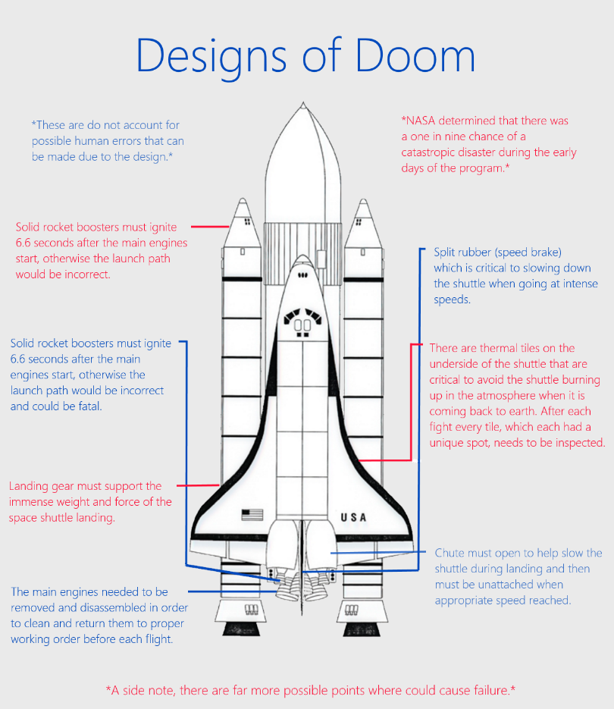
NASA
Even a slight issue is one of the many systems of can cause a catastrophic issues for the entire space shuttle. The design of every aspect of the shuttle is critical.

Slide 7
Sources
Amadeo, Ron. "Xiaomi Mi4 Review: China’s IPhone Killer Is Unoriginal but Amazing." Arstechnica. Conde Nast, 24 Aug. 2014. Web. 10 Nov. 2015.
Beijnum, Iljitsch Van. "It’s Official: North America out of New IPv4 Addresses." Arstechnica. Conde Nast, 2 July 2015. Web. 10 Nov. 2015.
Coffee, Thomas. Assessment of Design Impacts on Space Shuttle Operations and Recommendations for Manned Space Vehicle Programs (n.d.): n. pag. Mit.edu. Massachusetts Institute of Technology. Web. 10 Nov. 2015.
Denbroek, Angela Kristin. "The New Google Logo and Kerning." How to Be an Anthropologist. N.p., 3 Sept. 2015. Web. 12 Nov. 2015.
Hartman, Robin. "A Powerful History: The Modern Electrical Outlet." Illumin. University of Southern California, 19 June 2008. Web. 11 Nov. 2015.

